Slide 1
Business Plans & Elevator PitcheS
February 22, 2016
Nathan M. Wilson, Ph.D., M.B.A.
Anderson School of Management

Slide 2
Agenda
Overview
Business Plan Details
Elevator Pitches
Bonus Material
Business Model Canvas, Value Proposition Canvas, Environment Map
Industry Analysis
Blue Ocean Strategy

Slide 3
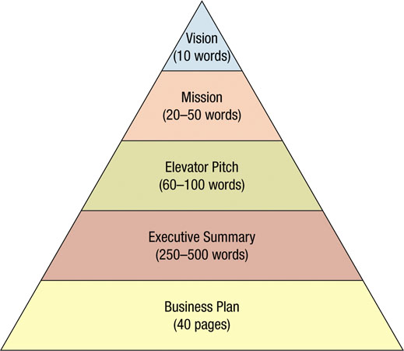
“Classical View”: Where does the Business Plan Fit?
Katz & Green

Slide 4
Everyone has a plan…
Reporter: “I hear your opponent has a clever plan for defensing your left hook. How do you respond?”
Mike Tyson: “Everyone has a plan until they get punched in the mouth.”

Slide 5
Three Fallacies of Business Plans (Steve Blank)
They rarely survive first contact with customers.
“Everyone has a plan until they get punched in the mouth.” – Mike Tyson
Five-year plans are generally “fiction”
Forecasting complete unknowns is almost always a waste of time.
Start-ups are not smaller versions of large companies.
Existing companies execute a business model; start-ups look for one.

Slide 6
Decades-Old Formula vs. Lean Startup
TRADITIONAL
Write a business plan
Pitch it to investors
Assemble a team
Operate in stealth mode
Release fully functional prototype
75% of all start-ups fail
LEAN STARTUP
Test hypotheses
Gather early & frequent customer feedback
Show MVP
Pivot
• Refining along the way for a
higher likelihood of success

Slide 7
Business Plans – Past, Present, and Future
“Coming up with creative ideas is easy; selling them to strangers is hard.”
Historically, entrepreneurs who wanted to found a business would start by writing a business plan
Defined ventures proposed strategy
The go-to-market strategy & operational models needed for strategy
Financial forecasts, risks, and invest plans
Business plans are much less common today
In the mid-1990s, most VC firms required a formal biz plan
May still be required by certain investors
More common inside of “large” companies
Evidence is mixed on how much value is created by writing a detailed traditional business plan

Slide 8
Business “Planning” Still Matters Even if “Plans” Don’t!
Entrepreneurs often revise the original idea or model for their business many times while planning or drafting a business plan
Debate among founders, trusted advisors, and partners as they clarify assumptions about the business model leads to a clearer understanding of areas of agreement and disagreement

Slide 9
Formulating a Business Plan
An opportunity to test ideas and determine whether viable business opportunities exist
The foundation for debating and analyzing key assumptions, developing financial forecasts, and designing early experiments
A baseline that clarifies aspirational milestones as the entrepreneur experiments to build a minimal viable product or service offering that will engage the market
A clear statement of the metrics that will be used to test assumptions and measure performance as the team works to achieve key milestones
An approach to communicating with others about the business while raising money; assembling a team; and attracting suppliers, customers, and partners

Slide 10
Useful Definitions
Business Model*: describes the rationale of how an organization creates, delivers, and captures value.
Business Plan: document that articulates the proposed venture’s business model and provides significant detail.
Business Pitch: presentation that be used to communicate model.
Targets include investors, partners, advisers, potential employees, etc.
Elevator Pitch: a one-paragraph description of a new business opportunity.
Elevator pitches are short! (one paragraph or 60-90 seconds)
Goal is to capture the interest of someone, not “complete the sale”
* Osterwalder & Pigneur, Business Model Generation.

Slide 11
Agenda
Overview
Business Plan Details
Elevator Pitches
Bonus Material
Business Model Canvas, Value Proposition Canvas, Environment Map
Industry Analysis
Blue Ocean Strategy

Slide 12
Business Plan Details
"The Ernst & Young Business Plan Guide" (2007), Brian R. Ford, Jay M. Bornstein, Patrick T. Pruitt, Third Edition, 2007, ISBN-10: 0470112697, ISBN-13: 978-0470112694, Edition: 3.

Slide 13
Traditional Business Plan Outline
Title Page
Key Sections*
Table of Contents
Executive Summary
General Company Description
Product and Services
Marketing Plan
Operational Plan
Management and Organization
Structure and Capitalization
Financial Plan
Appendices
* E&Y

Slide 14
Title Page & Table of Contents
Title Page
Contains introductory information
Company name
Contact information
Date this version of the plan was completed
Proprietary statement to protect your ideas
Table of contents
Lists major section headings
Optionally list sections underneath major sections
Put page numbers on every page of the business plan

Slide 15
Executive Summary
Captures and presents succinctly the essence of the plan
NOT a background statement nor is it an introduction
Provides the reviewer with a good understanding of:
The plan’s concept
Finances
Metrics
Ideally written AFTER you have written the plan
If you write first, ES can be vague and shallow
Entrepreneur may try and “force” the plan to conform to the “assumptions” or “statements” in the ES
Must succeed in generating immediate interest
Should highlight the business plan section-by-section

Slide 16
Product Section
Discuss the product or service description section of a business plan.
What business are you in?
What is the core competency of the business?
What's different about your product?
How have you differentiated it?
What is the value proposition you provide customers?
Why will the customer buy?
What is the compelling reason to buy?
Do you have patent protection?
Do you have a working prototype?

Slide 17
Detail Competition
Degree of competition
Begin with general statement regarding the level of relevant competition
Define what is truly competitive and treat in meaningful way
Careful: do not dismiss competition without just reasons
If there are a small number of competitors:
Identify each competitor
Detail strengths & weaknesses of each competitor
Discuss likely impact & reaction of each to your startup
Utilize graphics when possible!
Future sources of competition:
Typically depends on stability and growth of market
Critically important in cases of new product or service, where risk of imitators is significant

Slide 18
Market Section
Discuss the market section of the business plan.
Who is the target customer?
How do you describe him or her?
How do you define the market?
How is the market segmented?
What about trends, market size and growth potential?
What’s the relationship between market share and profitability?
Who is the competition?

Slide 19
Market Definition and Opportunity
Usually start with a discussion of the general industry background
Summarize industry growth or lack of growth
Sources of demand
How demand is satisfied
Utilize all resources:
Such as trade associations & trade literature
Industry studies
Experts
Detail depends on market potential & goals:
If potential is understood to be large & you only target a small %, less detail is needed
Larger market shares can require more detail

Slide 20
Marketing & Sales Section
Discuss the marketing and sales portion of the business plan.
How do you plan to market your product or service?
What strategies are you going to use?
Who is the competition?
How are you positioned versus your competition?
What is the pricing and business revenue model?
What are your sales strategy and tactics?
Who will sell the product? How?
How are you going to generate sales leads?
What's the sell cycle?

Slide 21
Marketing & Sales Section Discussion
Purpose: explain how the perspective business intends to manipulate and react to market conditions in order to generate sales
Must sell prospective business as:
Attractive opportunity
Good credit risk
Valued vendor of a product of service
Most venture capitalists feel the most important criteria for an investment is the size and potential of a market
“If a real market need is not presented, all of the talent and financing in the world will not make a company successful…”

Slide 22
Sales Forecasts
Sales Forecast: Analysis to justify anticipated sales volume. Should detail key assumptions.
Sales Forecast Breakdown
Time period
Demonstrate anticipated growth
Detail seasonality
Common to present multiple sales forecasts (e.g. conservative, most likely, optimistic).
Sales by product or service
Important if more than one product or service is being offered
Indicates relative importance of each of the business’s products, priorities, and how to allocate resources, etc.
Sales by customer group
If applicable, discuss distinct groups of customers, CLV, etc.
Market Share

Slide 23
Company Operations
Discuss company operations portion of your business plan.
What operations, manufacturing, logistics, sub-contracting, supplier relationships, capital investment requirements for infrastructure, facilities planning and major milestones are important for your business?

Slide 24
Operational Plan
A critical issue to be addressed in a business plan is how the business will create its products and services.
What is the approach to manufacturing?
What are the source(s) of raw materials?
What are the processes used in manufacturing?
What are the labor requirements?
How will suppliers and vendors be used?

Slide 25
Operational Plan - Details
Two potential uses for biz plan:
internal: may want to be very detailed for planning purposes & “thought experiments”
external: may have to be more straightforward for understanding
Entrepreneurs must strike balance between sophistication and simplicity in explaining complexity of operations
Think in terms of two questions:
Will the reviewer understand the content?
How important is the content to the overall understanding and appreciation of the business plan?

Slide 26
Management & Personnel Sections
Discuss the management and personnel sections of a business plan.
Is the management team important?
What is the executive equity compensation strategy?
Who should be on your board of directors?
What is a board of advisors? Should you have one?

Slide 27
Management and Organizations
Investors invest with People, not Ideas
Bet the Jockey, not the Horse
Vision without a Team = Failure
Questions to ask:
Participative or Autocratic
Profit Share or Commodity
Tasks or Flexible Responsibilities
What Culture to create

Slide 28
Management Team – General Pointers
Principals
Backgrounds
What do they bring?
Resources, connections, unique skills
Organizational Chart
Relationships and responsibilities
Policy and Strategies
Hiring practices
Compensation programs

Slide 29
Financial Section
Discuss the financial projections needed for a business plan.
What do you need for balance sheets in a biz plan?
What do you need for income (P&L) statements biz plan?
What do you need for cash flow statements in a biz plan?

Slide 30
Financial Section - General Pointers
Quality of research and reliability of data is critical
Financial plan must conform to the details presented in the remainder of the business plan
Useful to calculate multiple financial scenarios
Multiple financial scenarios helpful for sensitivity analysis
Any deviations from industry averages or financial ratios should be noted and explained
Review the section periodically and revise as necessary

Slide 31
Financial Section – Additional Details
Clearly list assumptions
Pro-forma income statements (3 to 5 years)
Monthly performance for YR1
Quarterly performance for YR 2 & YR 3
Yearly for YR 4 & YR 5
Pro-forma cash flow statements (3 to 5 years)
Monthly for YR 1
Quarterly for YR2 & YR 3
Yearly for YR 4 & YR 5
Current balance sheet and/or balance sheet after funding
Yearly balance sheet for YR1 – YR5
Additional financial projections (e.g. break-even analysis)

Slide 32
Role of Assumptions in Financial Section of a Business Plan
According to E&Y, what is the most integral part (i.e. important part) of the financial section?
ASSUMPTIONS!
Numbers without assumptions have NO meaning!
Investors review assumptions to see if you really understand business and your industry
Important aspects of assumptions:
Be compelling yet concise
Most important assumption is usually sales volume
The nature of the business dictates level of support & detail needed
Useful to provide multiple sets of assumptions (e.g. conservative, likely, optimistic)

Slide 33
Key Insights
The plan should be fun and easy to read.
The plan should tell a compelling story.
It’s not a mystery novel!
You should clearly indicate the status of prototypes etc.
You need to convince one of the judges to be your advocate, so don’t try and appease everyone, impress someone!
Once you lose credibility, people stop reading.
Markets that don’t exist don’t care how smart you are.
I want big markets and big returns, which means I have to take risks. I don’t want risk just for the sake of risk! De-risk when possible.

Slide 34
Agenda
Overview
Business Plan Details
Elevator Pitches
Bonus Material
Business Model Canvas, Value Proposition Canvas, Environment Map
Industry Analysis
Blue Ocean Strategy

Slide 35
Preparing the Pitch
Include facts, but remember the goal is to deliver a compelling story!
The pitch should be designed to grab the listeners attention and spark interest in learning more
Do your homework!
Is the objective of the pitch to gain financial commitments, attract partners, or some other purpose?
Research (i.e. stalk) your pitch audience
Practice, practice, and practice some more!
Do several “dry runs” with partners and advisers who already understand the business
After early test runs, practice presenting the pitch to supportive audiences who are in a position to give valuable feedback but who do not understand the new venture

Slide 36
Pitch Tips – Answer the Three Whys
Answer the Three Whys
Why this?
Why now?
Why this team?
Need to tell a story that makes the market’s “pain” real and that your solution is the right way to solve the pain
Typically the CEO does the talking for an investor pitch

Slide 37
TCA: Investor Presentation Guidelines

Slide 38
TCA: Pitch (Who are they and why should I care?)

Slide 39
TCA: People (Can this team deliver?)

Slide 40
TCA: Pain (Is the problem truly painful for the customer?)

Slide 41
TCA: Product (Is there a potentially great product here?)

Slide 42
TCA: Players (Who is your competition?)

Slide 43
TCA: Projections (Show me the money!)

Slide 44
TCA: (Summary and Q&A)

Slide 45
Example of a Pitch
EcoATM Pitch
https://www.youtube.com/watch?v=6Ybbi6-eId0

Slide 46
Agenda
Overview
Business Plan Details
Elevator Pitches
Bonus Material
Business Model Canvas, Value Proposition Canvas, Environment Map
Industry Analysis
Blue Ocean Strategy

Slide 47
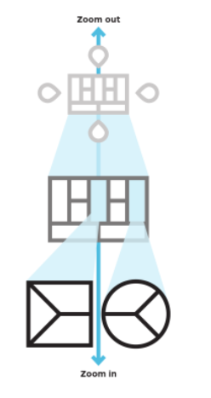
Integrated Suite of Tools*
The Environment Map
Helps you understand the context in which you create
The Business Model Canvas
Helps you create value for your business
The Value Proposition Canvas
Helps you create value for your customer
Business Model: describes the rationale of how an organization creates, delivers, and captures value.
* Osterwalder & Pigneur, Business Model Generation & Value Proposition Design

Slide 48
Environment Map

Slide 49
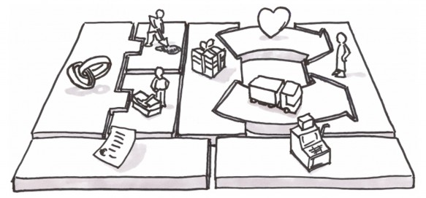
Business Model Canvas
https://www.youtube.com/watch?v=wwShFsSFb-Y&list=PLBh9h0LWoawphbpUvC1DofjagNqG1Qdf3

Slide 50
Value Proposition Canvas & Business Model Canvas

Slide 51
Value Proposition Canvas

Slide 52
Design a Value Proposition for Your Case!

Slide 53
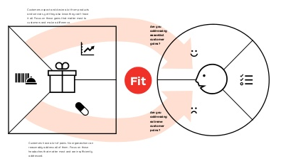
Problem Solution Fit
You achieve fit when customers get excited about your value proposition which happens when you address important jobs, alleviate extreme pains, and create essential gains that customers care about.

Slide 54
Three Kinds of Fit

Slide 55
© 2012 Steve Blank

Slide 56
Market vs. Industry
Industry: consists of sellers – typically organizations – that offer products or classes of products that are similar and close substitutes for one another
Market: consists of a group of current and/or potential customers having the willingness and ability to buy products (goods or services) to satisfy a particular class of wants or needs

Slide 57
TAM vs. TSM VS. Beachhead – Market is Not Sales!
Total Addressable Market: 100% of the market for type of product you sell (e.g. all coffee drinkers in USA)
Total Serviceable (or Served Available) Market: 100% of the market you could actually sell to (e.g. all coffee drinkers on-campus)
Target (Beachhead) Market: You initial most likely buyers.
Sales Forecast: Bottom-up forecast of how much you can sell given current or expected resources (e.g. # of salespeople, hours of operation, etc.)
Marketing: everything that you do to reach and persuade prospects (identifying and satisfying a customer need)
Sales: everything that you do to close the sale

Slide 58
TAM, TSM, Target market
Total Addressable Market
Total Serviceable Market
Target
Market
TAM ≥ TSM ≥ TARGET
NOTE: Not to scale!

Slide 59
Forces Governing Competition in an Industry

Slide 60
Blue Ocean Strategy
Red Oceans: represent all the industries in existence today. This is the known market space.
“bloody” with competition (profits and growth are reduced)
Blue Oceans: all the industries not in existence today. This is the unknown market space.
Potential of market space that is vast, deep, and not yet explored
To “seize” new profit and growth opportunities, companies need to create blue oceans

Slide 61
Strategy Canvas
Both a diagnostic and an action framework for building a compelling blue ocean strategy
Captures the current state of play in the known market space
The horizontal axis captures the range of factors the industry competes on and invests in
The vertical axis of the strategy canvas captures the offering level that buyers receive across all of the key factors (i.e. a high score means the company offers buyer more)
“Value Curve” – a graphical depiction of a company’s relative performance across its industry’s factors of competition

Slide 62
Example: U.S. Wine Industry
Stats (US market)
$20B annually
33rd in the world in per capita consumption
75% produced by top 8 companies, 1600+ wineries produce the rest
Competitive Factors
Price per bottle of wine
Elite, refined image packaging (e.g. medals won, esoteric terminology)
Marketing to raise consumer awareness in a crowded market space
Aging quality of wine
Prestige of a wine’s vineyard and its legacy
Complexity and sophistication of a wine’s taste, including such things as tannins and oak
A diverse range of wines to cover all varieties of grapes and consumer preferences

Slide 63
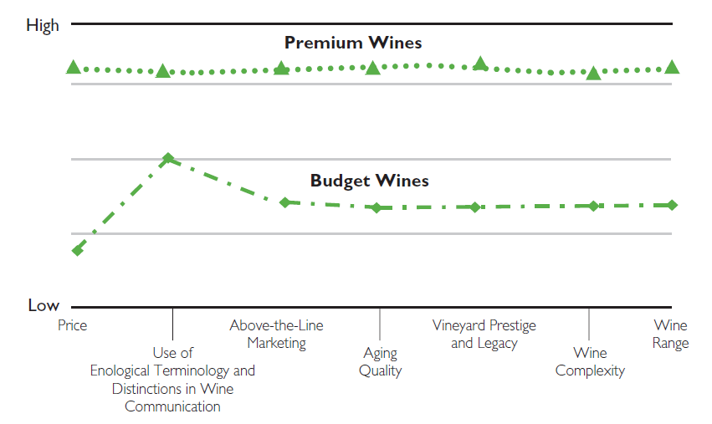
Strategy Canvas of U.S. Wine Industry (late ’90s)

Slide 64
[yellow tail] Goals
Convert noncustomers to customers
How to make a fun and easy-to-enjoy wine for every day?

Slide 65
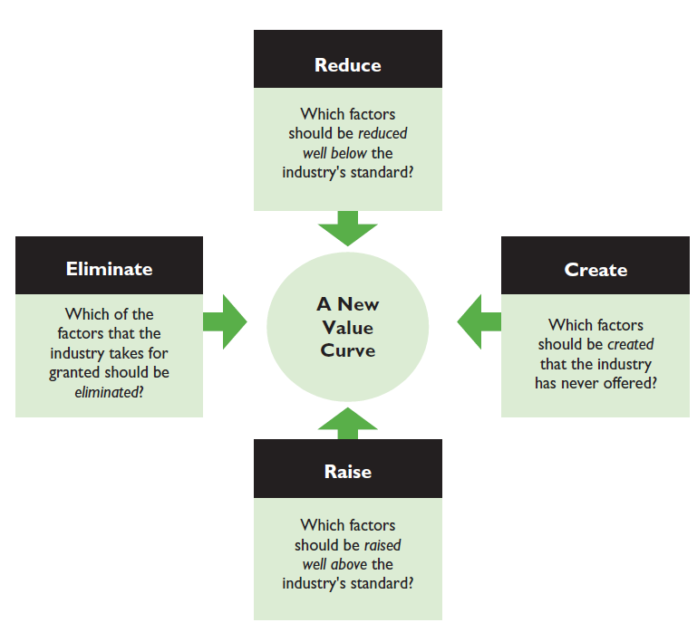
BOS: The Four Actions Framework

Slide 66
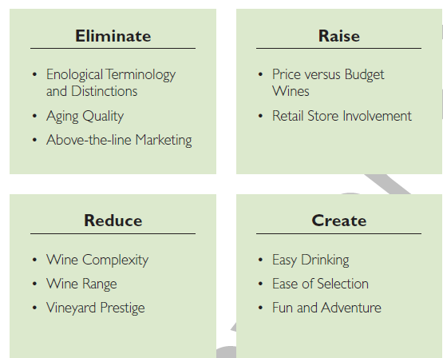
Eliminate-Reduce-Raise-Create Grid [yellow tail]

Slide 67
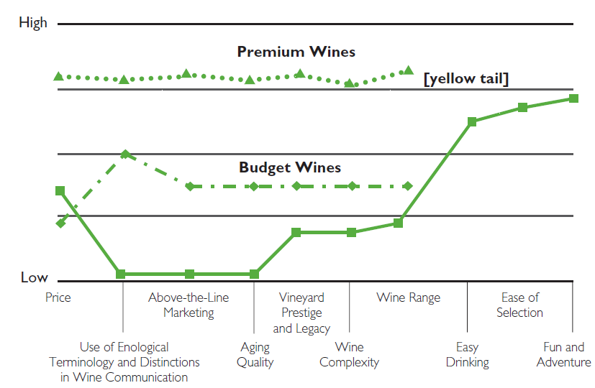
The Strategy Canvas for [yellow tail]

